Slide 1

For ROS2 Training with Pi
Robotics Programming with ROS2 Lecture 2 : ROS2 Fundamentals
By
Pi Thanacha Choopojcharoen

Slide 2
Agenda
For ROS2 Training with Pi
History of ROS
Getting to know ROS
Introduction to ROS 2
Navigating Linux Terminal
Using ROS2 in Terminal
ROS2 Node Programming with RCLPY
OOP with RCPLY
Custom Interface, Service Server, Service Client
Action, Multithread Execution, Callback Group
Main Objective:
To read the RCLPY-based code, create and customize basic ROS2 node.

Slide 3
Brief History of ROS
For ROS2 Training with Pi

Slide 4
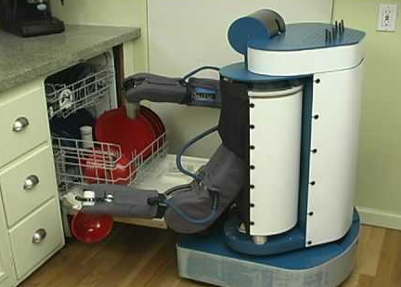
Before becoming ROS (Stanford University)
For ROS2 Training with Pi
Two majors common problem in robotics community
https://www.youtube.com/watch?v=9J9kxb_7dUg
Developers takes too much time developing basic structure of their robotics software.
Developers have little time working on new cutting-edge software for their robots.
Founders: Keenan Wyrobek และ Eric Berger (2006)
Brief History of ROS

Slide 5



The birth of ROS at Willow Garage (Menlo Park California)
For ROS2 Training with Pi
Scott Hassan (Founder & investor) was interested and invested in ROS. He started a new department called “Personal Robotics Program” in 2008.
Brief History of ROS

Slide 6
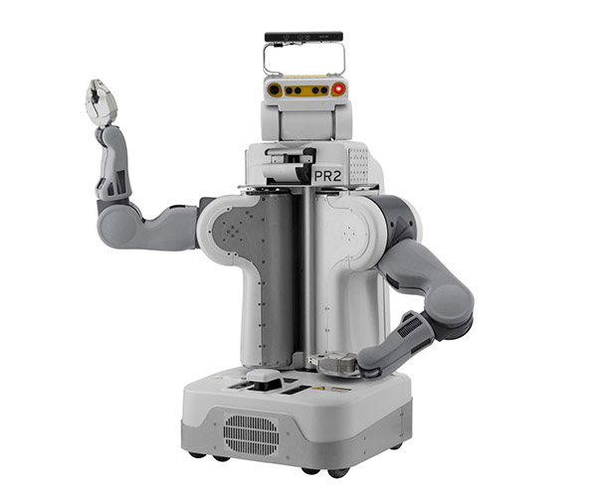
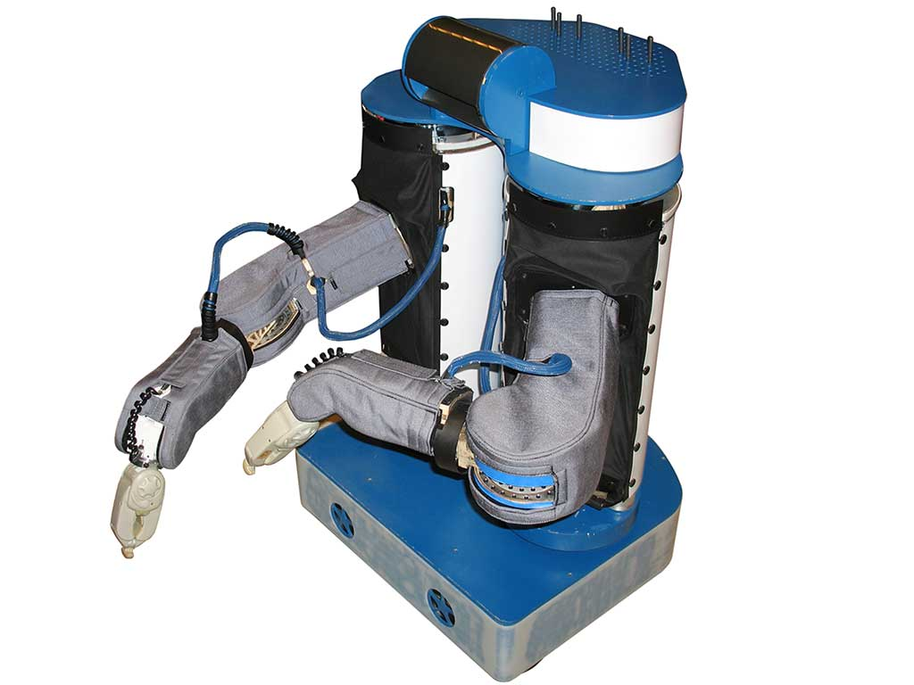
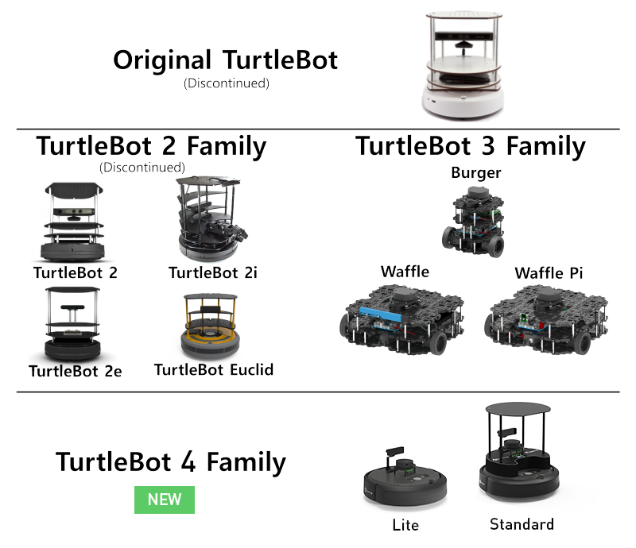
Products from Willow Garage
For ROS2 Training with Pi
PR2
PR1
Brief History of ROS

Slide 7



For ROS2 Training with Pi
Willow Garage shutdown in 2014. It spun off to several companies. , one being “Open Robotics”, formerly known as "Open Source Robotics Foundation".
https://www.youtube.com/watch?v=g0TaYhjpOfo
https://www.youtube.com/watch?v=HuJGIAjuxLE
Brief History of ROS

Slide 8


For ROS2 Training with Pi
Open Robotics is a non-profit corporation that is responsible for ROS, Gazebo Simulator, Ignition, and RMF.
In 2018, the company opened a new headquater in SIngapore. Open Robotics also collaborate with the goverment of Singapore to become a pioneer in Robotics medical tech.
Brief History of ROS

Slide 9
Getting to know ROS
For ROS2 Training with Pi

Slide 10
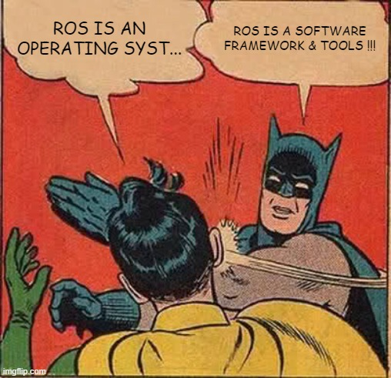
What is/ isn't ROS ?
For ROS2 Training with Pi
Robot Operating System (ROS) was often mistaken as an operating system due to its misleading name. ROS is actual a software framework for developing systems that consists of a cluster of computers. It is often used with a robotics hardware that have operating system.
Getting to know ROS

Slide 11

For ROS2 Training with Pi
Publish
Node
Broker
Node
Node
Node
Subscribe
Subscribe
Notes:
Ros เป็นไลบรารี่ การพัฒนาหนึ่งในการสื่อสารบนเครื่อข่าย ros คือ publish/subcribe ซึ่งมีลักษณะคล้ายกับ mqtt หรือ OPC
แต่เครือข่ายของ ros สามารถทำได้ดีในรูปแบบของพิกัดเฟรม หรือดครงสร้างข้อมูลที่พ่วงกับพิกัดเฟรม

Slide 12
For ROS2 Training with Pi
Node
Broker
Node
Node
Node
Subscribe
Subscribe
Notes:
Ros เป็นไลบรารี่ การพัฒนาหนึ่งในการสื่อสารบนเครื่อข่าย ros คือ publish/subcribe ซึ่งมีลักษณะคล้ายกับ mqtt หรือ OPC
แต่เครือข่ายของ ros สามารถทำได้ดีในรูปแบบของพิกัดเฟรม หรือดครงสร้างข้อมูลที่พ่วงกับพิกัดเฟรม

Slide 13
For ROS2 Training with Pi
Node
Broker
Node
Node
Node
Subscribe
Subscribe
Notes:
Ros เป็นไลบรารี่ การพัฒนาหนึ่งในการสื่อสารบนเครื่อข่าย ros คือ publish/subcribe ซึ่งมีลักษณะคล้ายกับ mqtt หรือ OPC
แต่เครือข่ายของ ros สามารถทำได้ดีในรูปแบบของพิกัดเฟรม หรือดครงสร้างข้อมูลที่พ่วงกับพิกัดเฟรม

Slide 14




For ROS2 Training with Pi
Node
Broker
Node
Node
Node
Notes:
Ros เป็นไลบรารี่ การพัฒนาหนึ่งในการสื่อสารบนเครื่อข่าย ros คือ publish/subcribe ซึ่งมีลักษณะคล้ายกับ mqtt หรือ OPC
แต่เครือข่ายของ ros สามารถทำได้ดีในรูปแบบของพิกัดเฟรม หรือดครงสร้างข้อมูลที่พ่วงกับพิกัดเฟรม

Slide 15
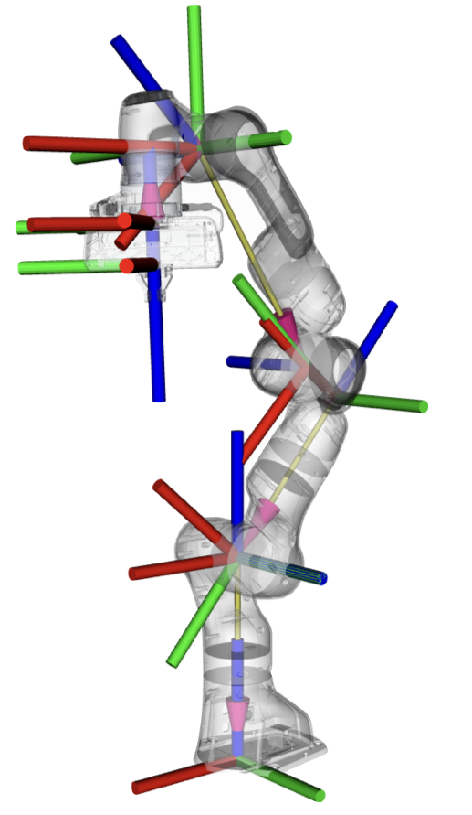
For ROS2 Training with Pi
Publish
Node
Broker
Node
Node
Node
Subscribe
Subscribe
Notes:
Ros เป็นไลบรารี่ การพัฒนาหนึ่งในการสื่อสารบนเครื่อข่าย ros คือ publish/subcribe ซึ่งมีลักษณะคล้ายกับ mqtt หรือ OPC
แต่เครือข่ายของ ros สามารถทำได้ดีในรูปแบบของพิกัดเฟรม หรือดครงสร้างข้อมูลที่พ่วงกับพิกัดเฟรม

Slide 16
What does ROS do ????
For ROS2 Training with Pi
Tools, Standards, Conventions
Resource Sharing Platform
Getting to know ROS

Slide 17
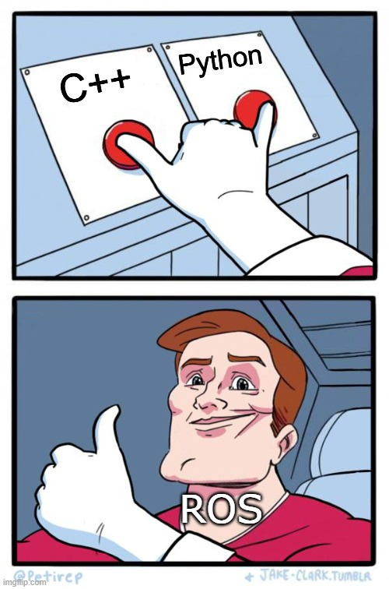
Suported Programming Language for ROS
For ROS2 Training with Pi
Getting to know ROS

Slide 18






Suported Programming Language for ROS
For ROS2 Training with Pi
Getting to know ROS

Slide 19

Common type of information used in robotics
For ROS2 Training with Pi
ROS Message Types
Accel Inertia Point Point32 Pose Pose2D Quaternion Transform Twist Vector3 Wrench
BatteryState CameraInfo CompressedImage Image Imu JointState Joy LaserScan PointCloud Temperature
Getting to know ROS

Slide 20
Packages for/by the ROS Community
For ROS2 Training with Pi
If your idea is simple, it is most likely to exist as a ROS package.
rviz
gazebo
aruco_detect
global_planner
ros_control
map_server
camera_calibration
Getting to know ROS

Slide 21
ROS Distribution & End-of-Life (EOL)
For ROS2 Training with Pi
Distro | Release date | EOL date
ROS Noetic Ninjemys | May 23rd, 2020 | May, 2025
ROS Melodic Morenia | May 23rd, 2018 | May, 2023
ROS Lunar Loggerhead | May 23rd, 2017 | May, 2019
ROS Kinetic Kame | May 23rd, 2016 | April, 2021
ROS Jade Turtle | May 23rd, 2015 | May, 2017
ROS Indigo Igloo | July 22nd, 2014 | April, 2019
ROS Hydro Medusa | September 4th, 2013 | May, 2015
ROS Groovy Galapagos | December 31, 2012 | July, 2014
ROS Fuerte Turtle | April 23, 2012 | --
ROS Electric Emys | August 30, 2011 | --
ROS Diamondback | March 2, 2011 | --
ROS C Turtle | August 2, 2010 | --
ROS Box Turtle | March 2, 2010 | --
Is release year … ?
is even number
is oddnumber
Support = 5 years
Support = 2 years
Getting to know ROS

Slide 22
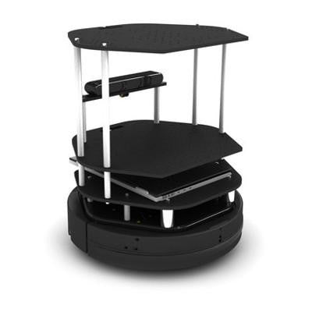
Physical System vs Simulation
For ROS2 Training with Pi
Algorithm = ????
Getting to know ROS

Slide 23
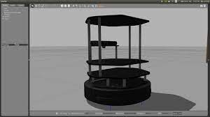
For ROS2 Training with Pi
Physical System vs Simulation
Simulation-in-the-loop Test
Algorithm
model
Getting to know ROS

Slide 24
Physical System vs Simulation
For ROS2 Training with Pi
Tuning
Algorithm
Model
Getting to know ROS
Getting to know ROS

Slide 25
Physical System vs Simulation
For ROS2 Training with Pi
Tuning with the simulation
Algorithm
model
Getting to know ROS

Slide 26
Physical System vs Simulation
For ROS2 Training with Pi
A robot needs a computer.
Algorithm
So does the simulation.
Getting to know ROS

Slide 27
Physical System vs Simulation
For ROS2 Training with Pi
A robot needs a computer.
Algorithm
So does the simulation.
Q1.) Should they use the same computer ?
Getting to know ROS

Slide 28
Physical System vs Simulation
For ROS2 Training with Pi
A robot needs a computer.
Algorithm
So does the simulation.
Q2.) Which one should be more powerful ?
Getting to know ROS

Slide 29
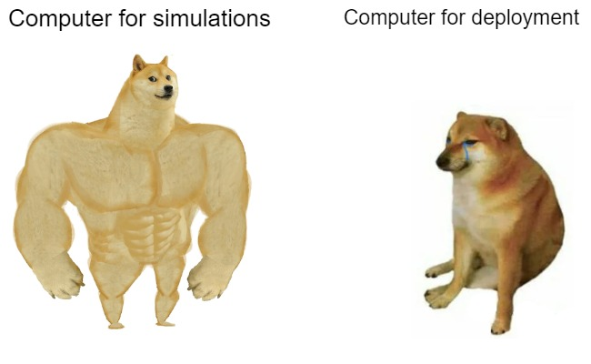
Physical System vs Simulation
For ROS2 Training with Pi
Algorithm
Getting to know ROS

Slide 30


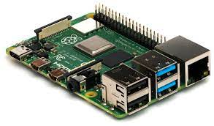
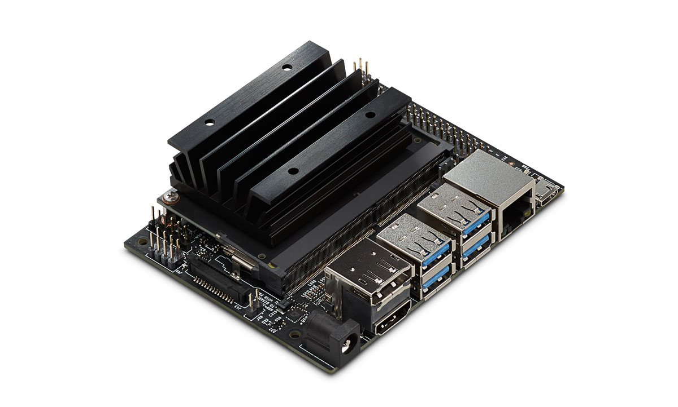
System Requirement for ROS
For ROS2 Training with Pi
Hardware
Graphic Card for simulator
>1.6 GHz, Dual-core (Intel i5 processor or better)
4 GB RAM
Operating System
Ubuntu, Fedora
***Windows 10,11 (some bug still exists in old distro)
Getting to know ROS

Slide 31
Introduction to ROS2
For ROS2 Training with Pi

Slide 32
Issues from using ROS (1)
For ROS2 Training with Pi
ROS was not designed to support a system of multiple robots due to its used of a single master node.
ROs was designed so that the resources should be local (contains within the computer) for optimal performance
The paradigm of communication was not design to support realtime operation.
ROS was essentially a centralized system, which is not designed to support fleet management.
Introduction to ROS2

Slide 33

ROS 2
For ROS2 Training with Pi
Some of many benefits of ROS2
Utilize Data Distribution System instead of TCPROS
Support multiple operating system such as linux, Windows, and OSX
Launch files can be writen using Python script !!!
Introduction to ROS2

Slide 34
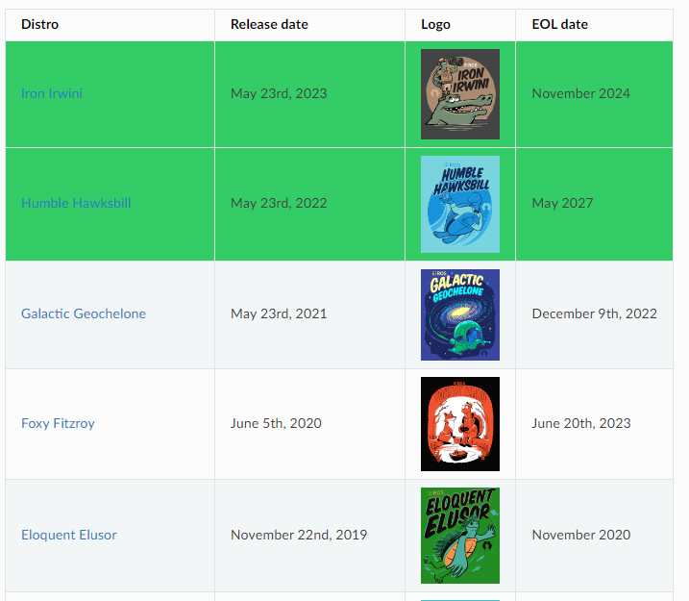
ROS2 Distro
For ROS2 Training with Pi
Introduction to ROS2

Slide 35
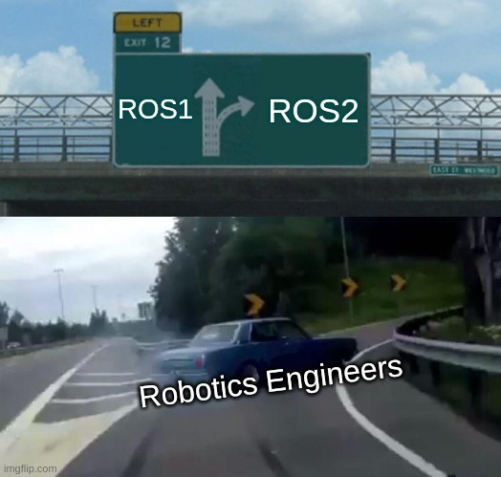
Let's use ROS2 !!!
For ROS2 Training with Pi
ROS 2 : Humble
(Ubuntu 22.04)
Introduction to ROS2

Slide 36
Navigating Linux Terminal
For ROS2 Training with Pi

Slide 37
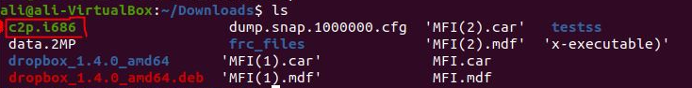
Linux: File System & Path
For ROS2 Training with Pi
"Directory" : where one can keep their files or other sub-directories.
"File" : a content that requires an extension. (.jpg, .py, .cpp)
"Data file" : contains data that can be read or written by an editor or other programs.
"Executable file" : can be executed to perform certain task(s)
"Path" : describe the location of a directory or file
Navigating Linux Terminal

Slide 38
Common questions one should ask themselves
For ROS2 Training with Pi
Which files does our system need ?
How can we make sure that the system will use the correct files regardless of the computer it was installed on ?
What should the system behave when the required file does not exist ?
Navigating Linux Terminal

Slide 39
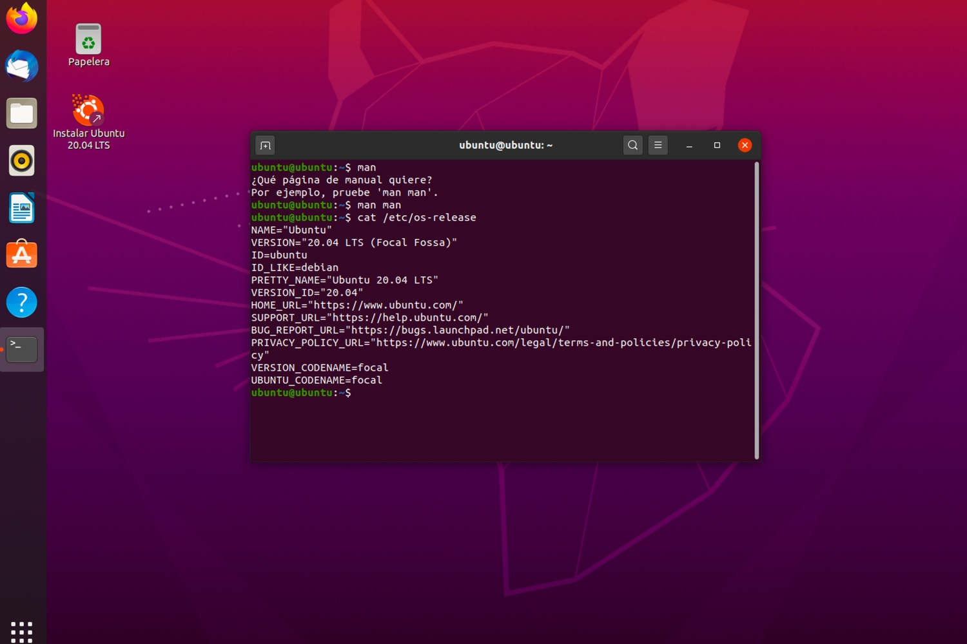
Ubuntu : Terminal & Command
For ROS2 Training with Pi
One can execute a command in a terminal.
Navigating Linux Terminal

Slide 40
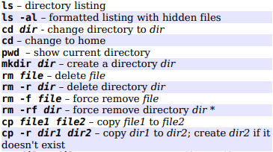
Ubuntu : Common Command
For ROS2 Training with Pi
List all installed ROS package
>> apt list ros-humble* --installed
Install a ROS package
>> sudo apt install ros-humble-[PACKAGE]
Open file explorer from the current working direcrtory
>> nautilus .
Modify bashrc
>> code ~/.bashrc
Navigating Linux Terminal

Slide 41
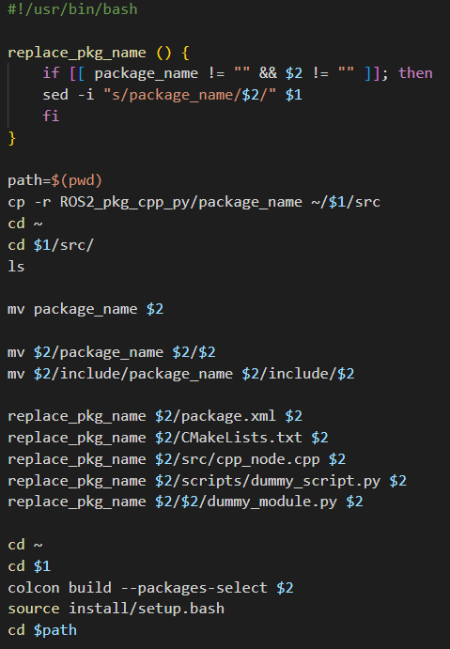
Bash Programming
For ROS2 Training with Pi
>> cd
>> code my_script.bash
if [ -d "$1" ];
then
cd $1
else
echo "The directory $1 does not exist."
echo "Creating directory $1"
mkdir -p $1/src
cd $1
fi
>> source my_script.bash
Navigating Linux Terminal

Slide 42
.bashrc
For ROS2 Training with Pi
.bashrc is a hidden bash script in Home directory that will be called automatically when opening a new terminal.
echo Please enter new terminal name : read terminal_name TITLE=“\[\e]0;$terminal_name\a\]” PS1=$PS1${TITLE}
>> cd >> code .bashrc
>> code ~/.bashrc
Navigating Linux Terminal

Slide 43
Using ROS2 in terminal
For Robotics Programming with ROS2 by CoXsys Robotics only

Slide 44
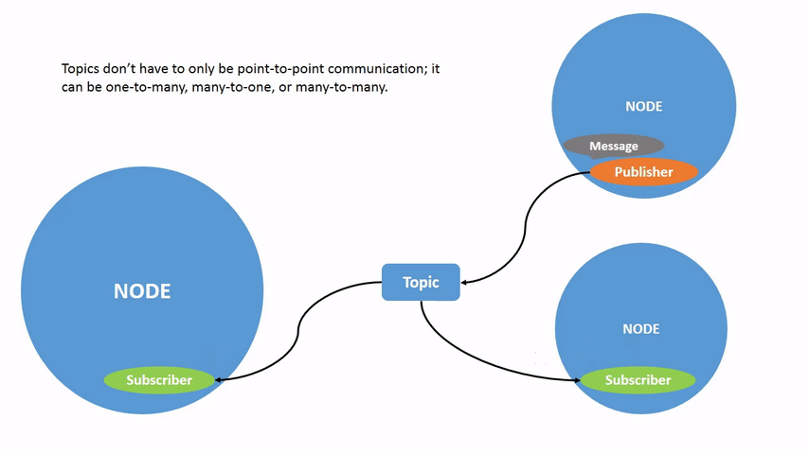
The concept of Nodes and Topics
For ROS2 Training with Pi
NODE
process
TOPIC
Communication Channel
Node can have a publisher that publish a message to a topic.
Node can also have a subscription that subscribe a message from a topic.
Using ROS2 in Terminal

Slide 45
The concept of Nodes and Topics
For ROS2 Training with Pi
NODE
process
TOPIC
Communication Channel
Q1.) Can a node have both a publisher and a subscription to the same topic ?
Using ROS2 in Terminal

Slide 46
The concept of Nodes and Topics
For ROS2 Training with Pi
NODE
process
TOPIC
Communication Channel
Q2.) Should a node have both a publisher and a subscription to the same topic ?
Using ROS2 in Terminal

Slide 47
The concept of Nodes and Topics
For ROS2 Training with Pi
ros2 run [package_name] [executable] ros2 node list
ros2 node info [node_name] --verbose ros2 topic list
/turtle1/pose
publish
/turtlesim
P
S
subscribe
/turtle1/cmd_vel
ros2 run turtlesim turtlesim_node
Using ROS2 in Terminal

Slide 48
The concept of Nodes and Topics
For ROS2 Training with Pi
ros2 run [package_name] [executable] ros2 node list ros2 topic list
/turtle1/pose
publish
/turtlesim
/teleop
subscribe
/turtle1/cmd_vel
publish
ros2 run turtlesim turtlesim_node
ros2 run turtlesim turtle_teleop_key
Using ROS2 in Terminal

Slide 49
The concept of Nodes and Topics
For ROS2 Training with Pi
/turtle1/pose
publish
subscribe
/turtlesim
/turtlesim_controller
subscribe
/turtle1/cmd_vel
publish
Using ROS2 in Terminal

Slide 50
The concept of message
For ROS2 Training with Pi
turtlesim/Pose
ros2 topic echo [topic_name] ros2 topic info [topic_name] ros2 interface show [message_type]
/turtle1/pose
/turtlesim
Twist :
linear:
x
y
z
angular:
x
y
z
Type of message
/turtle1/cmd_vel
geometry_msgs/Twist
ros2 run turtlesim turtlesim_node
Using ROS2 in Terminal

Slide 51
Publising messages from the terminal
For ROS2 Training with Pi
/turtle1/pose
/turtlesim
ros2 topic pub –r [rate in Hz] [topic_name] [message_type] “[data]"
/turtle1/cmd_vel
YAML format
ros2 topic pub –r 10 /turtle1/cmd_vel geometry_msgs/msg/Twist {linear: {x: 2.0, y: 0.0, z: 0.0}, angular: {x: 0.0, y: 0.0, z: 1.8}}
Using ROS2 in Terminal

Slide 52
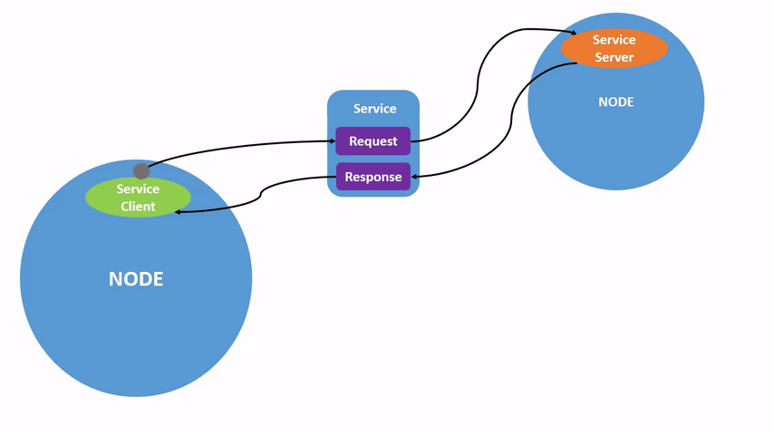
The concept of service
For ROS2 Training with Pi
ros2 service list ros2 service info [service_name] ros2 interface show [service_type] ros2 service call [service_name] [service_type] [request_data]
1-1 communication
Suitable for more private communication that happens once in a while
Node can have a service server that provides service to a service client from other nodes.
Using ROS2 in Terminal

Slide 53
The concept of ROS2 Parameter
For ROS2 Training with Pi
ros2 param list ros2 param get [node_name] [parameter_name] ros2 param set [node_name] [parameter_name] [value] ros2 param dump [node_name] ros2 param load [node_name] [parameter_file] ros2 run [package_name] [executable] --ros-args –params-file [file_name]
/turtlesim
[background_g=86]
Parameter is a constant that is associated with that particular node. It can be modified and accessed by terminal interface.
Using ROS2 in Terminal

Slide 54
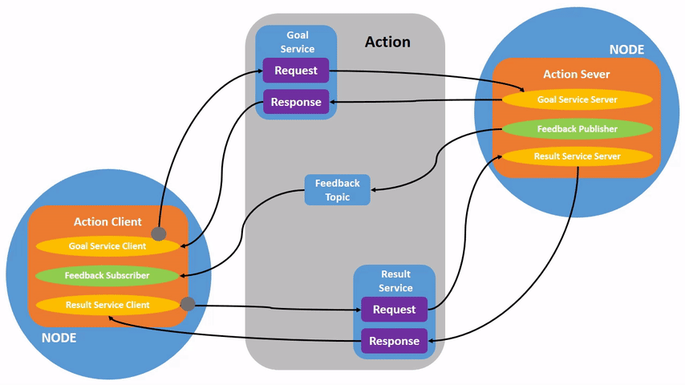
The concept of action
For ROS2 Training with Pi
ros2 action list ros2 action info [action_name] ros2 interface show [action_type] ros2 action send_goal [action_name] [action_type] [value] -f
1-1 communication
Suitable for task that requires time to complete such as planning, optimizing, navigating, etc.
A node can have an action server that execute an "action", then return the result to the client.
Using ROS2 in Terminal

Slide 55
Using existing system with ROS2
For ROS2 Training with Pi
Given existing ROS2 packages, we can now know how to execute some of their functionalities via terminal command.
Let's create our own ROS2 node and packages.
Using ROS2 in Terminal

Slide 56
Before create a ROS2 node
For ROS2 Training with Pi
What will happen :
Node will be defined in a file.
Node will be executed via an executable.
Node may require other data files.
Questions :
Where do we need to keep the definition of node ?
Where do we need to keep the executable ?
If the node is to be used in other computers, how can we organize the associated files systematically ?
Using ROS2 in Terminal

Slide 57
ROS2 Package Customization
For ROS2 Training with Pi

Slide 58
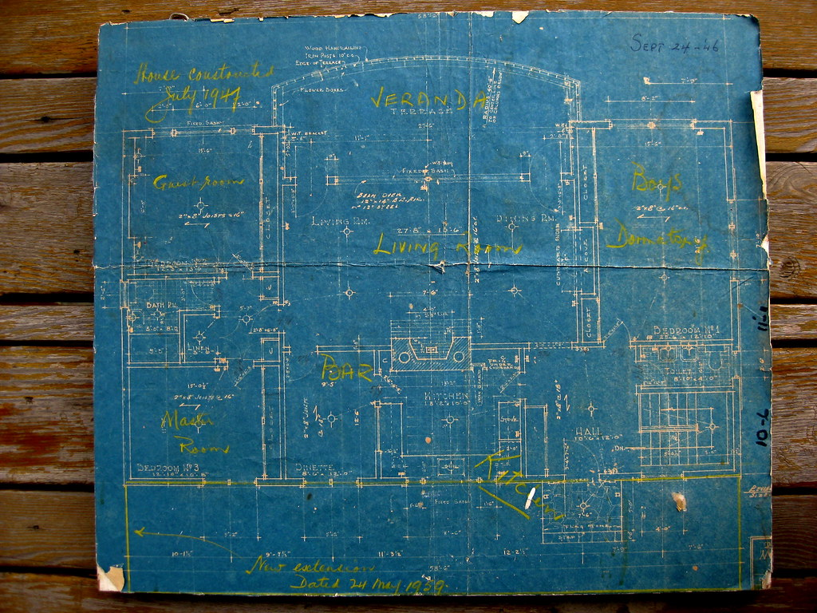
The concept of Package
For ROS2 Training with Pi
[pkg]
Package is a collection of organized files in a form of directory, which will used to "synthesize" nodes, launch system, etc. (usually for a specific task)
An anology of a package would be a folder where we can keep all blue prints of a house but not the house itself.
ROS2 Package Customization

Slide 59
The concept of Package
For ROS2 Training with Pi
sensor_calibration
ros_to_uart
trajectory_generator
But, where do we keep our packages ?
ROS2 Package Customization

Slide 60
Source folder (src)
For ROS2 Training with Pi
src
sensor_calibration
ros_to_uart
trajectory_generator
"src" directory is where we put all custom packages together.
A package can be put inside another folder, which can be referred as a meta-package.
ROS2 Package Customization

Slide 61
The concept of Workspace
For ROS2 Training with Pi
[workspace]
src
[ROS2] workspace is where we put every custom packages for a project.
ROS2 Package Customization

Slide 62
Build System
For ROS2 Training with Pi
[workspace]
[workspace]
colcon build
src
src
build
install
log
"colcon build" command will build every packages in the source directory and generate 3 additional directories. When modify "src", always re-build these 3 directories. (with an exception of using symlink install)
ROS2 Package Customization

Slide 63
Build System
For ROS2 Training with Pi
[workspace]
[workspace]
colcon build
src
src
build
install
log
"Install" directory is the location of codes that will be used by the ROS2 system. Therefore, only modifying "src" will not change the behavior of your system in run time.
ROS2 Package Customization

Slide 64
Build System
For ROS2 Training with Pi
You must not create workspace inside another workspace
[workspace]
[workspace]
colcon build
src
src
build
install
log
"Install" directory is the location of codes that will be used by the ROS2 system. Therefore, only modifying "src" will not change the behavior of your system in run time.
ROS2 Package Customization

Slide 65
Creating a new workspace
For ROS2 Training with Pi
Create and build a new workspace
Adding workspace to .bashrc
>> mkdir –p ~/[xxx]_ws/src >> cd ~/[xxx]_ws >> colcon build
source ~/[xxx]_ws/install/local_setup.bash
ROS2 Package Customization

Slide 66
Package Layout
For ROS2 Training with Pi
src
include
C++ Headers
CMakeLists.txt
C++ code
CMake
test
doc
README
Test data
.doc/.pdf
[pkg]
config
Setting Parameters
launch
package.xml
Launch file
Package Identifier
[pkg_name]
setup.py*
LICENSE
py code
https://automaticaddison.com/organizing-files-and-folders-inside-a-ros-2-package/
ROS2 Package Customization

Slide 67
Creating a ROS Package
For ROS2 Training with Pi
>> cd ~/[xxx]_ws/src >> ros2 pkg create --build-type ament_python [package_name]
Package with Python
>> cd ~/[xxx]_ws/src >> ros2 pkg create --build-type ament_cmake [package_name]
Package with C++
The package that we create must be in the src directory of our workspace.
WCreating a ROS Packagehat if we have both C++ and Python files ?
ROS2 Package Customization

Slide 68
Creating my_first_pkg
For ROS2 Training with Pi
>> cd ~/[xxx]_ws/src >> ros2 pkg create --build-type ament_python my_first_pkg >> cd .. >> colcon build --packages-select my_first_pkg >> cd src/my_first_pkg >> code package.xml
>> cd my_first_pkg >> code my_first_script.py
https://ocs.ros.org/en/diamondback/api/licenses.html
ROS2 Package Customization

Slide 69
Creating my_first_pkg
For ROS2 Training with Pi
>> cd ~/[xxx]_ws/src >> ros2 pkg create --build-type ament_python my_first_pkg >> cd .. >> colcon build --packages-select my_first_pkg >> cd src/my_first_pkg >> code package.xml
>> cd my_first_pkg >> code my_first_script.py
What if we have both C++ and Python files ?
https://ocs.ros.org/en/diamondback/api/licenses.html
ROS2 Package Customization

Slide 70
Using ROS_pkg_cpp_py
For ROS2 Training with Pi
>> cd ~
>> git clone https://github.com/tchoopojcharoen/ROS2_pkg_cpp_py
>> source ROS2_pkg_cpp_py/install_pkg.bash {YOUR_WORKSPACE} {PACKAGE_NAME}
ROS2 Package Customization

Slide 71
Package Layout
For ROS2 Training with Pi
src
include
C++ Headers
CMakeLists.txt
C++ code
CMake
test
doc
package.xml
Test data
.doc/.pdf
Package Identifier
[pkg]
config
Setting Parameters
launch
LICENSE
Launch file
[pkg_name]
scripts
py module
py script
https://automaticaddison.com/organizing-files-and-folders-inside-a-ros-2-package/
ROS2 Package Customization

Slide 72
Structure of CMakeLists.txt for building a package
For ROS2 Training with Pi
compile and create executable
add_executable(my_exe_name src/my_exe.cpp)
ament_target_dependencies(my_exe_name rclcpp)
install(TARGETS
my_exe_name
DESTINATION lib/$(PROJECT_NAME)
)
install(PROGRAMS
scripts/my_scripts.py
scripts/my_scripts_2.py
DESTINATION share/$(PROJECT_NAME)
)
install(DIRECTORY
launch
config
DESTINATION share/$(PROJECT_NAME)
)
ament_package()
# C++ Dependencies
find_package(ament_cmake REQUIRED)
find_package(rclcpp REQUIRED)
# Python Dependencies
find_package(ament_cmake_python REQUIRED)
find_package(rclpy REQUIRED)
# add C++ include
include_directories(include)
# add PythonModule
ament_python_install_package($(PROJECT_NAME))
manage
dependencies
put executable in install
put scripts in install
put directories in install
ROS2 Package Customization

Slide 73
Creating Package Manually (C++ & Python)
For ROS2 Training with Pi
Create a package with ament_cmake
Create a new folder with the same name as the package and add an empty python file with the name __init__.py
Make sure that all scripts consists of (#!/usr/bin/python3) in the beginning of the file
Apply "chmod +x" to all Python executables
>> cd [path to workspace
>> find src/[package_name]/scripts -exec chmod +x {} \;
Add additional folders such as launch, config, etc
Modify CMakeLists.txt accordingly
Python executable
Folder
Custom Interface
src
C++ code
CMakeLists.txt
(C++,Python)
include
[pkg_name]
C++ headers
package.xml
[pkg_name]
__init__.py
python module
scripts
python executable
ROS2 Package Customization

Slide 74
ROS2 Node Programming with RCLPY
For ROS2 Training with Pi

Slide 75
Node class in ROS Client Library for Python (RCLPY)
For ROS2 Training with Pi
rclpy.node.Node
rclpy.pusblisher.Publisher
Subscriber callback
Timer_callback
Service server callback
publishers
subscriptions
timers
services
clients
executor
topic_name
publish
create_publisher
create_subscription
create_timer
create_service
create_client
get_clock
get_logger
get_name
rclpy.client.Client
-
call
call_async
remove_pending_request
service_is_ready
wait_for_service
ROS2 Node Programming with RCLPY

Slide 76
General procedure on "running" a node using RCLPY
For ROS2 Training with Pi
Initialize rclpy using 'rclpy.init'
Instantiate a "Node" object
Spin node using rclpy.spin or spin once in a while-loop
If the processs exits the loop, de-construct the node
Shut down rclpy using rclpy.shutdown
ROS2 Node Programming with RCLPY

Slide 77
Inheriting a Node class from RCLPY
For ROS2 Training with Pi
Import the superclass "Node"
from rclpy.Node import Node
class NewNode(Node):
def __init__(self):
super().__init__('node_name')
def main(args=None):
rclpy.init(args=args)
node = NewNode()
rclpy.spin(node)
node.destroy_node()
rclpy.shutdown()
"NewNode" inherits from "Node"
Running a node of class "NewNode"
ROS2 Node Programming with RCLPY

Slide 78
Timer, Publisher, & Subscription
For ROS2 Training with Pi

Slide 79
Attaching a timer to the node
For ROS2 Training with Pi
class NewNode(Node):
def __init__(self):
super().__init__('node_name')
self.timer = self.create_timer(1.0,timer_callback)
def timer_callback():
print('Hello World')
Period of the timer
Attaching the callback
Defining callback as a function
Timer, Publisher, & Subscription

Slide 80
Attaching a timer to the node
For ROS2 Training with Pi
class NewNode(Node):
def __init__(self):
super().__init__('node_name')
self.count = 0
self.timer = self.create_timer(1.0,self.timer_callback)
def timer_callback(self):
print(self.count)
self.count = self.count + 1
Defining new attribute
Make a value persist by accessing the attribuate of te instance
Defining callback as a method of the class
Timer, Publisher, & Subscription

Slide 81
Attaching a publisher and publishing a message in a timer
For ROS2 Training with Pi
from std_msgs/msg import Int32
class NewNode(Node):
def __init__(self):
super().__init__('node_name')
self.count = 0
self.timer = self.create_timer(1.0,self.timer_callback)
self.pub = self.create_publisher(Int32,'output',10)
def timer_callback(self):
self.count = self.count + 1
msg = Int32()
msg.data = self.count
self.pub.publish(msg)
Import type of message
create a publisher
Instantiate a new message
publish a message
Timer, Publisher, & Subscription

Slide 82
Exercise 0 : Driving in Circle
For ROS2 Training with Pi
turtlesim
turtlesim_controller
/turtle1/pose
Create a node that allows the associated turtle to drive in circle.
/turtle1/cmd_velocity
/turtle1/cmd_velocity
Timer, Publisher, & Subscription

Slide 83
Attaching a subscription and its callback
For ROS2 Training with Pi
from std_msgs/msg import Int32
class NewNode(Node):
def __init__(self):
super().__init__('node_name')
self.pub = self.create_publisher(Int32,'output',10)
self.sub = self.create_subscription(Int32,'input',self.sub_callback,10)
def subscription_callback(self,msg):
pub_msg = Int32()
pub_msg.data = msg.data + 1
Self.pub.publish(pub_msg)
Import type of message
create a subscription
Argument format of subscription callback
These lines will be executed when 'input' is published by other node(s)
Timer, Publisher, & Subscription

Slide 84

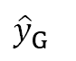
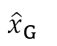
Exercise 1: Position Control
For ROS2 Training with Pi
turtlesim
position_controller
goal
$${\hat{y}}_{G}$$
/turtle1/pose
/turtle1/cmd_velocity
/turtle1/goal
turtle
$${\hat{x}}_{G}$$
/turtle1/cmd_velocity
/turtle1/cmd_velocity
Objective : The turtle must reach the goal.
Timer, Publisher, & Subscription

Slide 85
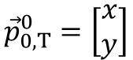
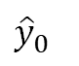

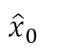
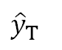
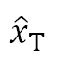
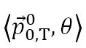
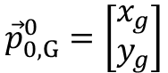
Exercise 1: Position Control
For ROS2 Training with Pi
turtlesim
$$\left\langle {\vec{p}}_{0,T}^{0},θ\right\rangle$$
position_controller
$${\vec{p}}_{0,G}^{0}=\left[\begin{aligned}x_{g} \\ y_{g}\end{aligned}\right]$$
$${\hat{y}}_{0}$$
$${\hat{y}}_{T}$$
/turtle1/pose
/turtle1/cmd_velocity
/turtle1/goal
$${\hat{x}}_{T}$$
$$θ$$
$${\vec{p}}_{0,T}^{0}=\left[\begin{aligned}x \\ y\end{aligned}\right]$$
$${\hat{x}}_{0}$$
/turtle1/cmd_velocity
/turtle1/cmd_velocity
Timer, Publisher, & Subscription

Slide 86
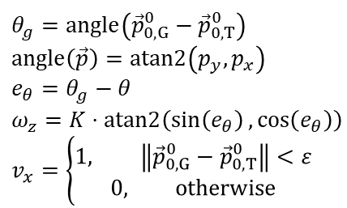
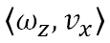
Exercise 1: Position Control
For ROS2 Training with Pi
turtlesim
$$\left\langle {\vec{p}}_{0,T}^{0},θ\right\rangle$$
position_controller
$${\hat{y}}_{0}$$
$${\hat{y}}_{T}$$
/turtle1/pose
/turtle1/cmd_velocity
/turtle1/goal
$$θ_{g}=angle\left({\vec{p}}_{0,G}^{0}−{\vec{p}}_{0,T}^{0}\right) \\ angle\left(\vec{p}\right)=atan2\left(p_{y},p_{x}\right) \\ e_{θ}=θ_{g}−θ \\ ω_{z}=K⋅atan2\left(\sin\left(e_{θ}\right),\cos\left(e_{θ}\right)\right) \\ v_{x}=\left\{\begin{aligned}1, \left\|{\vec{p}}_{0,G}^{0}−{\vec{p}}_{0,T}^{0}\right\|<ε \\ 0, otherwise\end{aligned}\right.$$
$${\hat{x}}_{T}$$
$$θ$$
$$\left\langle ω_{z},v_{x}\right\rangle$$
$${\hat{x}}_{0}$$
/turtle1/cmd_velocity
/turtle1/cmd_velocity
Timer, Publisher, & Subscription

Slide 87
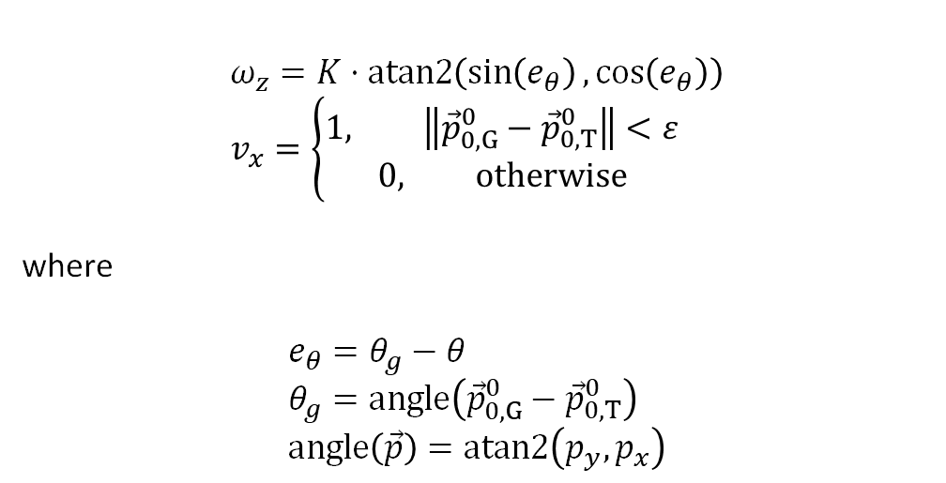
Go-to-goal Control Policy
For ROS2 Training with Pi
$$ω_{z}=K⋅atan2\left(\sin\left(e_{θ}\right),\cos\left(e_{θ}\right)\right) \\ v_{x}=\left\{\begin{aligned}1, \left\|{\vec{p}}_{0,G}^{0}−{\vec{p}}_{0,T}^{0}\right\|<ε \\ 0, otherwise\end{aligned}\right.$$
where
$$e_{θ}=θ_{g}−θ \\ θ_{g}=angle\left({\vec{p}}_{0,G}^{0}−{\vec{p}}_{0,T}^{0}\right) \\ angle\left(\vec{p}\right)=atan2\left(p_{y},p_{x}\right)$$
$${\hat{y}}_{0}$$
$${\hat{y}}_{T}$$
$${\hat{x}}_{T}$$
$$θ$$
$${\hat{x}}_{0}$$
Timer, Publisher, & Subscription

Slide 88
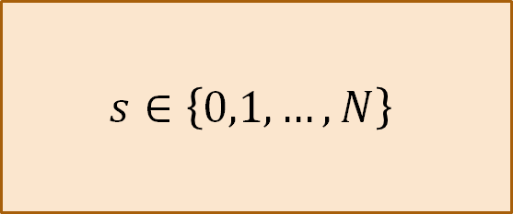
Finite State Machine
For ROS2 Training with Pi
inputs
$$s∈\left\{0,1,…,N\right\}$$
outputs
FSM consists of discrete amount of possible states .
There 2 types of updating scheme for an FSM.
1.) Updating at fixed time interval (Time-driven)
2.) Updating when particular events occur (Event-driven)
Timer, Publisher, & Subscription

Slide 89
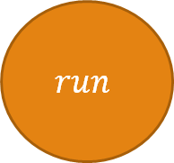
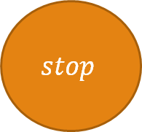
Finite State Machine
For ROS2 Training with Pi
transition
inputs
$$stop$$
$$run$$
outputs
Possible State
Timer, Publisher, & Subscription

Slide 90
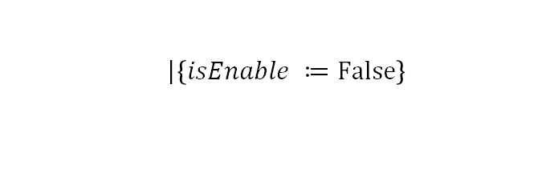

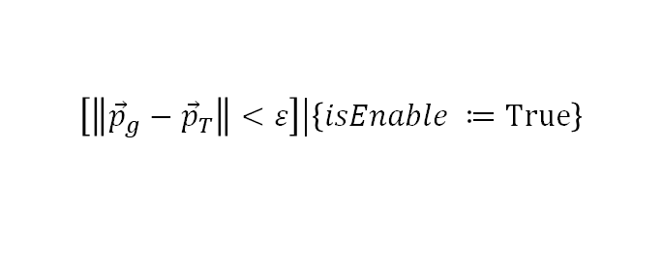
Finite State Machine
For ROS2 Training with Pi
$$\left.\right|\left\{isEnable ≔False\right\}$$
$$\left.\left[\left\|{\vec{p}}_{g}−{\vec{p}}_{T}\right\|<ε\right]\right|\left\{isEnable ≔True\right\}$$
inputs
$$stop$$
$$run$$
outputs
$$\left.\left[????\right]\right|\left\{isEnable ≔False\right\}$$
Timer, Publisher, & Subscription

Slide 91
Exercise 1: Position Control
For ROS2 Training with Pi
turtlesim
$$\left\langle {\vec{p}}_{0,T}^{0},θ\right\rangle$$
Only publish when the turtle is far from the goal.
position_controller
$${\hat{y}}_{0}$$
$${\hat{y}}_{T}$$
/turtle1/pose
/turtle1/cmd_velocity
/turtle1/goal
$$θ_{g}=angle\left({\vec{p}}_{0,G}^{0}−{\vec{p}}_{0,T}^{0}\right) \\ angle\left(\vec{p}\right)=atan2\left(p_{y},p_{x}\right) \\ e_{θ}=θ_{g}−θ \\ ω_{z}=K⋅atan2\left(\sin\left(e_{θ}\right),\cos\left(e_{θ}\right)\right) \\ v_{x}=\left\{\begin{aligned}1, \left\|{\vec{p}}_{0,G}^{0}−{\vec{p}}_{0,T}^{0}\right\|<ε \\ 0, otherwise\end{aligned}\right.$$
$${\hat{x}}_{T}$$
$$θ$$
$$\left\langle ω_{z},v_{x}\right\rangle$$
$${\hat{x}}_{0}$$
/turtle1/cmd_velocity
/turtle1/cmd_velocity
Timer, Publisher, & Subscription

Slide 92
Creating multiple nodes that do similar tasks
For ROS2 Training with Pi
What if we want to create anoter controller that follow another turtle ?
Should we refine everything ?
Timer, Publisher, & Subscription

Slide 93
Object-Oriented Programming
For ROS2 Training with Pi

Slide 94
Shared Features & Functionality
For ROS2 Training with Pi
TurtleFollower
ViaPointFollower
Use go-to-goal to follow a turtle
Use go-to-goal to follow a turtle
Object-Oriented Programming

Slide 95
Shared Features & Functionality
For ROS2 Training with Pi
Knowing the location of the associated turtle
Sending control input to turtlesim
Using the same control law
TurtleFollower
ViaPointFollower
Object-Oriented Programming

Slide 96
Shared Features & Functionality
For ROS2 Training with Pi
Knowing the location of the associated turtle
Sending control input to turtlesim
Using the same control law
TurtleFollower
ViaPointFollower
The goal is turtle's pose
The goal is a position.
Object-Oriented Programming

Slide 97
Object-Oriented Programming
For ROS2 Training with Pi
PositionController
subscribe to a turtle's pose
publish Twist message to command velocity
have its internal state machine
TurtleFollower
ViaPointFollower
subscribe to a turtle's pose
subscribe to a point
Object-Oriented Programming

Slide 98
Exercise 2: Leader & Follower
For ROS2 Training with Pi
turtlesim
turtle_follower
/turtle2/pose
/turtle2/cmd_velocity
/turtle2/goal
/turtle2/cmd_velocity
/turtle2/cmd_velocity
Create 2 ROS nodes that allows a "follower" turtle to follow another "leader" turtle while the "leader" turtle follows a given goal.
These 2 nodes must share the same "parent" class.
via_point_follower
/turtle1/pose
/turtle1/cmd_velocity
/turtle1/goal
/turtle1/cmd_velocity
/turtle1/cmd_velocity
Object-Oriented Programming

Slide 99
Exercise 2: Leader & Follower
For ROS2 Training with Pi
Terminal 1
>> ros2 run turtlesim turtlesim_node
Terminal 2
>> ros2 service call /spawn turtlesim/srv/Spawn "{x: 2.0, y: 2.0, theta: 0.0, name: 'turtle2'"}
Terminal 3
>> ros2 run turtlesim_control turtle_follower.py
Terminal 4
>> ros2 run turtlesim_control via_point_follower.py --ros-args -r /turtle2/goal:=/turtle1/pose
Object-Oriented Programming

Slide 100
Exercise 2: Leader & Follower
For ROS2 Training with Pi
Terminal 1
>> ros2 run turtlesim turtlesim_node
Terminal 2
>> ros2 service call /spawn turtlesim/srv/Spawn "{x: 2.0, y: 2.0, theta: 0.0, name: 'turtle2'"}
Terminal 3
>> ros2 run turtlesim_control turtle_follower.py
Terminal 4
>> ros2 run turtlesim_control via_point_follower.py --ros-args -r /turtle2/goal:=/turtle1/pose
What if the turtle's name changes to something else ?
Do we need to write a new file ?
Object-Oriented Programming

Slide 101
Remapping & namespace
For ROS2 Training with Pi

Slide 102
Inconsistent topic names
For ROS2 Training with Pi
Publisher
Publish to '/topic_a'
/topic_a
/topic_c
Subscription
Subscribe to '/topic_c'
Remapping & Namespace

Slide 103
Remapping Topics
For ROS2 Training with Pi
Outside of our code, we can "remap" the name of the topic in the command line.
In the code, we can change the subscribed topic to "pose" instead of using "/turtle1/pose".
We can apply the same idea to other topics.
In the command line, we can add arguments at the end.
>> ros2 run turtlesim_control - -ros-args -r /pose:=/turtle1/pose
Publisher
Publish to '/topic_a'
remap /topic_a:=/topic_b
/topic_b
remap /topic_c:=/topic_b
Subscription
Subscribe to '/topic_c'
This only change the name, not the type
Remapping & Namespace

Slide 104
Having the same type of nodes in ROS network
For ROS2 Training with Pi
/control_input
controller : robot_1
/control_output
Remapping & Namespace

Slide 105
Having the same type of nodes in ROS network
For ROS2 Training with Pi
/control_input
/control_input
controller : robot_1
controller : robot_2
/control_output
/control_output
Remapping & Namespace

Slide 106
Having the same type of nodes in ROS network
For ROS2 Training with Pi
/control_input
controller : robot_1
controller : robot_2
/control_output
Remapping & Namespace

Slide 107
Distinguishing topics using namespace
For ROS2 Training with Pi
/robot_1/control_input
/robot_2/control_input
robot_1/controller
robot_2/controller
/robot_1/control_output
/robot_2/control_output
Remapping & Namespace

Slide 108
Topic with Namespace
For ROS2 Training with Pi
One can also add "namespace" to an entire node, which appends the namespace to the front of every name without "/" in the front.
For example, pose => /namespace/pose
turtle_follower = > /namespace/turtle_follower
/goal => /goal
In the command line, we can add arguments at the end.
>> ros2 run turtlesim_control - -ros-args -r __ns:=/turtle1
Remapping & Namespace

Slide 109
Service Server & Service Client
For ROS2 Training with Pi

Slide 110
Attaching a service server and its callback
For ROS2 Training with Pi
from std_srvs/srv import Empty
class NewNode(Node):
def __init__(self):
super().__init__('node_name')
self.count = 0
self.srv = self.create_service(Empty,'my_service',self.srv_callback)
def srv_callback(self,request,response):
self.count = self.count + 1
return response
Service Server & Service Client

Slide 111
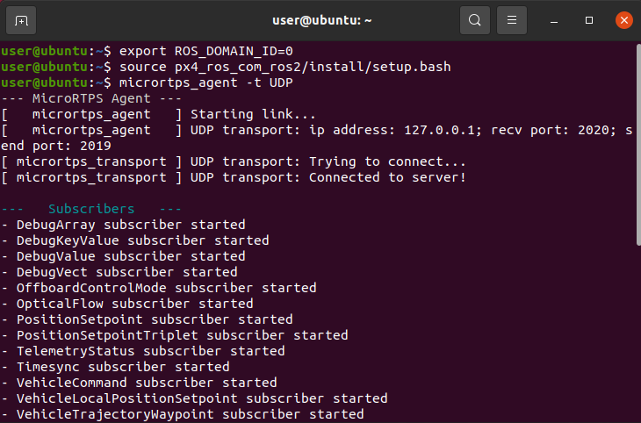
Exercise 3: Controller with services
For ROS2 Training with Pi
turtlesim
via_point_follower
/turtle1/pose
/turtle1/cmd_velocity
Service server
Empty
/randomize_goal
Empty
/turtle1/cmd_velocity
/turtle1/cmd_velocity
Service Server & Service Client

Slide 112
Exercise 3: Controller with services
For ROS2 Training with Pi
turtlesim
via_point_follower
/turtle1/pose
/turtle1/cmd_velocity
Service server
Empty
/randomize_goal
randomized_goal
We must define a new type of interface.
/turtle1/cmd_velocity
/turtle1/cmd_velocity
Service Server & Service Client

Slide 113
Custom Interface
For ROS2 Training with Pi
Pose.msg
InvKin.srv
.action
geometry_msgs/Point position
geometry_msgs/Quaternion orientation
geometry_msgs/Point position
geometry_msgs/Quaternion orientation
---
sensor_msgs/JoinState joint_config
geometry_msgs/Point position
geometry_msgs/Quaternion orientation
---
sensor_msgs/JoinState joint_config
---
int64 sec
int64 nanosec
Interface name must start with uppercase letter and must not contain underscore or other unqie characters. The field itself must start with lowercase letter.
Service Server & Service Client

Slide 114
Custom Interface
For ROS2 Training with Pi
Pose.msg
InvKin.srv
.action
geometry_msgs/Point position
geometry_msgs/Quaternion orientation
geometry_msgs/Point position
geometry_msgs/Quaternion orientation
---
sensor_msgs/JoinState joint_config
geometry_msgs/Point position
geometry_msgs/Quaternion orientation
---
sensor_msgs/JoinState joint_config
---
int64 sec
int64 nanosec
request message
response message
Service Server & Service Client

Slide 115
Custom Interface
For ROS2 Training with Pi
Pose.msg
InvKin.srv
.action
geometry_msgs/Point position
geometry_msgs/Quaternion orientation
geometry_msgs/Point position
geometry_msgs/Quaternion orientation
---
sensor_msgs/JoinState joint_config
geometry_msgs/Point position
geometry_msgs/Quaternion orientation
---
sensor_msgs/JoinState joint_config
---
int64 sec
int64 nanosec
goal message
result message
feedback message
Service Server & Service Client

Slide 116
Package with custom interface
For ROS2 Training with Pi
msg
srv
action
[something]_interfaces
CMakeLists.txt
***
package.xml
***
Service Server & Service Client

Slide 117
CMakeLists.txt (custom interface)
For ROS2 Training with Pi
Search for dependent packages
find_package(geometry_msgs REQUIRED) find_package(rosidl_default_generators REQUIRED)
rosidl_generate_interfaces(${PROJECT_NAME}
"msg/Num.msg"
"msg/Sphere.msg"
"srv/AddThreeInts.srv"
DEPENDENCIES geometry_msgs
)
Generating custom definition
Associating the dependency
Service Server & Service Client

Slide 118
package.xml (custom interface)
For ROS2 Training with Pi
Adding
dependent packages
<depend>geometry_msgs</depend>
<build_depend>rosidl_default_generators</build_depend>
<exec_depend>rosidl_default_runtime</exec_depend>
<member_of_group>rosidl_interface_packages</member_of_group>
Service Server & Service Client

Slide 119
Custom Interface for our turtlesim
For ROS2 Training with Pi
turtlesim_interfaces
CMakeLists.txt
package.xml
Service Server & Service Client

Slide 120
custom service
For ROS2 Training with Pi
srv
turtlesim_interfaces
RandGoal.srv
CMakeLists.txt
package.xml
Service Server & Service Client

Slide 121
Exercise 3: Controller with services
For ROS2 Training with Pi
turtlesim
via_point_follower
/turtle1/pose
/turtle1/cmd_velocity
empty
/randomize_goal
randomized_goal
????
/set_goal
????
/turtle1/cmd_velocity
/turtle1/cmd_velocity
Service Server & Service Client

Slide 122
Synchronous vs Asynchronous Programming
For ROS2 Training with Pi
Service Client
Service Server
Service Client
Service Server
Call the server and send request
Call the server and send request
Wait for the response
Get the response
Continue the process
Get the response
Continue the process
Synchronous
Asynchronous
Service Server & Service Client

Slide 123
Future Object (RCLPY)
For ROS2 Training with Pi
Service Client
Service Server
call_async(request) -> future
Get the response
Example:
If the "future" is done, print and update some variables.
future.add_done_callback(callback)
Asynchronous
Service Server & Service Client

Slide 124
Attaching a service client
For ROS2 Training with Pi
from std_srvs/srv import Empty
class NewNode(Node):
def __init__(self):
super().__init__('node_name')
self.cli = self.create_client(Empty,'my_service')
req = Empty.Request()
self.future = self.cli.call_async(req)
self.future.add_done_callback(self.done_callback)
def done_callback(self,future):
print(future.result())
Service Server & Service Client

Slide 125
Exercise 4: Controller with services
For ROS2 Training with Pi
turtlesim
via_point_follower
scheduler
/turtle1/pose
/turtle1/cmd_velocity
Contain a set of via points
Send a pair of via point
/set_goal
/set_goal
/rand_goal
[optional]
/turtle1/cmd_velocity
/turtle1/cmd_velocity
Service Server & Service Client

Slide 126
Exercise 4: Controller with services
For ROS2 Training with Pi
turtlesim
via_point_follower
scheduler
/turtle1/pose
/turtle1/cmd_velocity
When notified, send a new pair of via points
/set_goal
/set_goal
/notify_arrival
/notify_arrival
/turtle1/cmd_velocity
/turtle1/cmd_velocity
Service Server & Service Client

Slide 127
Exercise 4: Controller with services
For ROS2 Training with Pi
Terminal 1
>> ros2 run turtlesim turtlesim_node
Terminal 2
>> ros2 run turtlesim_control via_point_follower.py --ros-args -r __ns:=/turtle1
Terminal 3
>> ros2 run turtlesim_control scheduler.py __ns:=/turtle1
Service Server & Service Client

Slide 128
Time-driven vs. Event-driven
For ROS2 Training with Pi
turtlesim
controller
scheduler
/turtle1/pose
/turtle1/cmd_velocity
EVENT-DRIVEN
/set_goal
/set_goal
TIME-DRIVEN
/notify_arrival
/notify_arrival
/turtle1/cmd_velocity
/turtle1/cmd_velocity
Service Server & Service Client

Slide 129
Waiting for a task to complete
For ROS2 Training with Pi
What if instead of only setting a goal, we also wait for the turtle to reach the goal ?
When it reaches the goal, it should return the total distance (Euclidean).
In the meantime, it should publish the elasped time.
Service Server & Service Client

Slide 130
Action, Callback Group, & Multithread Execution
For ROS2 Training with Pi

Slide 131
Action & Single Thread Execution
For ROS2 Training with Pi
notify_client
action_server notify_server
execute_callback
Called by action client
If flag is True, exit the wait.
Action, Callback Group, & Multithread Execution

Slide 132
Action & Single Thread Execution
For ROS2 Training with Pi
notify_client
action_server notify_server
execute_callback
Called by action client
If flag is True, exit the wait.
Client calls the server.
Action, Callback Group, & Multithread Execution

Slide 133
Deadlock
For ROS2 Training with Pi
notify_client
action_server notify_server
execute_callback
Called by action client
Client calls the server.
Flag is never triggered
Never exit (Deadlock)
Action, Callback Group, & Multithread Execution

Slide 134
Multithread Execution
For ROS2 Training with Pi
notify_client
notify_server
action_server
execute_callback
Action, Callback Group, & Multithread Execution

Slide 135
Multithread Execution
For ROS2 Training with Pi
notify_client
notify_server
action_server
execute_callback
Called by action client
Action, Callback Group, & Multithread Execution

Slide 136
Multithread Execution
For ROS2 Training with Pi
Both threads are spun
notify_client
notify_server
action_server
execute_callback
Called by action client
Call notify server
Action, Callback Group, & Multithread Execution

Slide 137
Multithread Execution
For ROS2 Training with Pi
notify_client
notify_server
action_server
execute_callback
Called by action client
Call notify server
Flag is triggered
Action, Callback Group, & Multithread Execution

Slide 138
Multithread Execution
For ROS2 Training with Pi
notify_client
notify_server
action_server
execute_callback
Called by action client
Call notify server
Flag is triggered
Exit the wait
Action, Callback Group, & Multithread Execution

Slide 139
Multithread Execution
For ROS2 Training with Pi
notify_client
notify_server
action_server
execute_callback
Called by action client
Call notify server
Flag is triggered
Exit the wait
Perform some cleanup tasks before exit the callback
Action, Callback Group, & Multithread Execution

Slide 140
Callback Groups
For ROS2 Training with Pi
2 different Mutually Exclusive Callback Groups
notify_client
notify_server
action_server
execute_callback
Called by action client
Call notify server
Flag is triggered
Exit the wait
Perform some cleanup tasks before exit the callback
Action, Callback Group, & Multithread Execution

Slide 141
Exercise 5: Action Interface
For ROS2 Training with Pi
turtlesim
via_point_follower
follower_interface
/turtle1/pose
/turtle1/cmd_velocity
/go_to_goal
/set_goal
/set_goal
/get_position
/get_position
/notify_arrival
/notify_arrival
/turtle1/cmd_velocity
/turtle1/cmd_velocity
Action, Callback Group, & Multithread Execution

Slide 142
Summary
For ROS2 Training with Pi
History of ROS
Getting to know ROS
Introduction to ROS 2
Navigating Linux Terminal
Using ROS2 in Terminal
ROS2 Node Programming with RCLPY
OOP with RCPLY
Custom Interface, Service Server, Service Client
Action, Multithread Execution, Callback Group

